Slide 1
Spatial Search Optimization for 2D top-down shooter AI using QuadTree
C++ Godot Engine
Kukuh Basuki Rahmat

Slide 2
Research Topic
Research Goal
C++ optimization, improving execution time.
Reduce execution time of enemy medic AI in getting closest enemy to heal

Slide 3
Problem Definition
Current Implementation
Enemy Medic AI Responsibilities
If have target
Follow target
Heal target
Else
Find closest injured enemy
player
enemy
enemy medic
Check distance to all enemy
Get reference to closest
AI will take (medic x enemies) computation. Gets worse with longer gameplay and more enemy.

Slide 4
Proposed Solution
Instead of using all enemy as search space:
⇒ spatially differentiate enemy, create hierarchy of spatial bounds
⇒ using QuadTree data structure
Worst Case (enemies all in one quadrant) (medic x enemies) Best Case (enemies uniformly distributed) (medic x enemies)
Visual
Representation
Data Representation
1
4^{depth}

Slide 5
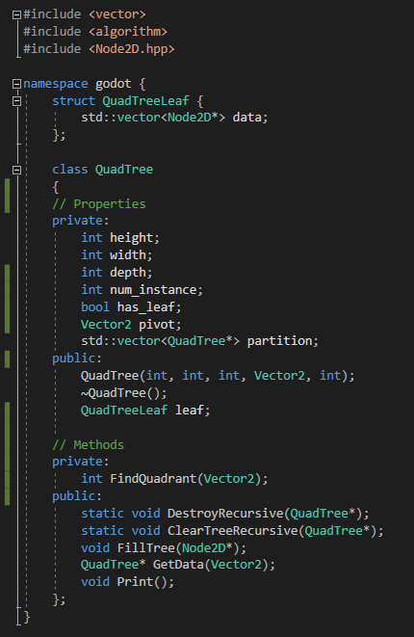
Implementation of Solution
height, width | Arena dimension
depth | Tree depth remaining, 0 at leaf
num_instance | How many enemy at current tree
has_leaf | Boolean for Leaf data is availability
pivot | Point of quadrant segmentation
partition | QuadTree child (4 instances for NW, NE, SW, SE)
FindQuadrant | Determine quadrant of Vector2 relative to pivot
FillTree | Recursively place enemy reference at appropriate leaf
GetData | Returns QuadTree that has leaf available with enemy references
Print | Print tree for debug
Clear & Destroy | Clear empty all data but preserve structure Destroy called at destructor to prevent memory leak

Slide 6
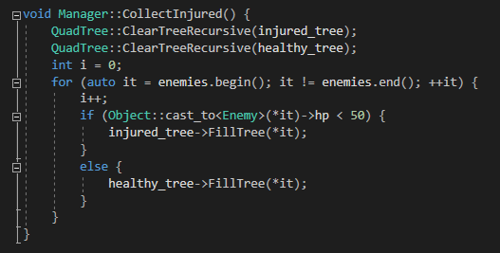
Implementation of Solution (Manager Class)
Before
After
Singleton manager keeps:
vector<Node2D*> enemies
vector<Node2D*> injured_enemies
Push new instantiated enemies, pop dead enemies.
Able to be accessed from EnemyMedic class.

Slide 7
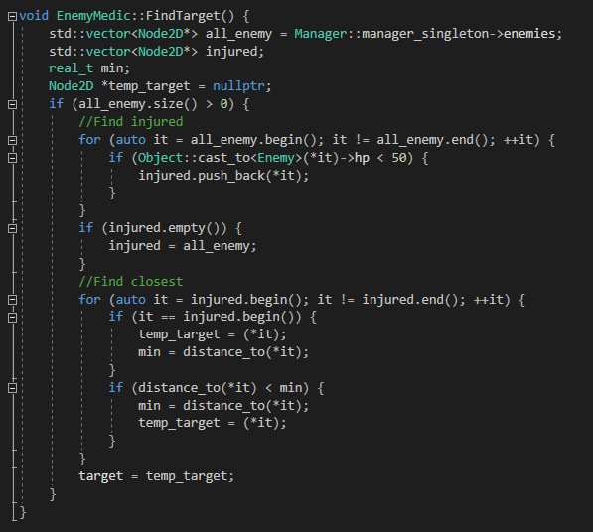
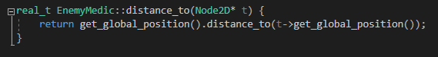
Implementation of Solution (EnemyMedic class)
Before
Get enemy vector from manager
Traverse for injured enemies
Find closest nodes

Slide 8
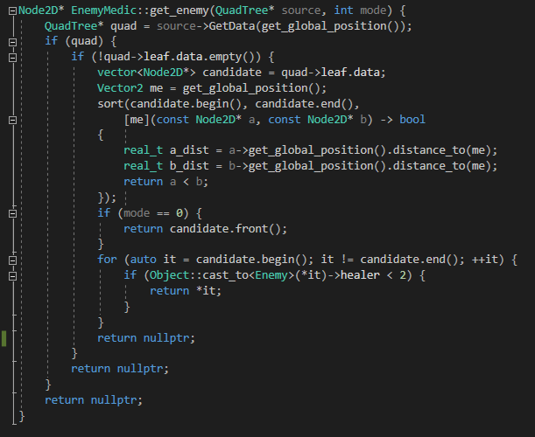
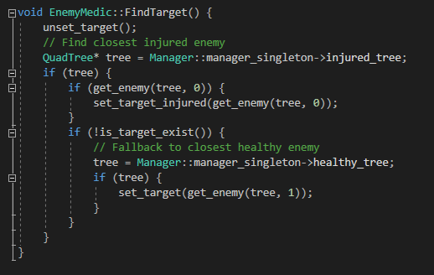
Implementation of Solution (EnemyMedic class)
After

Slide 9
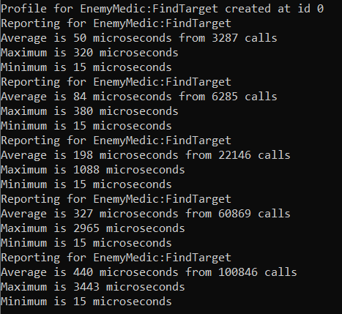
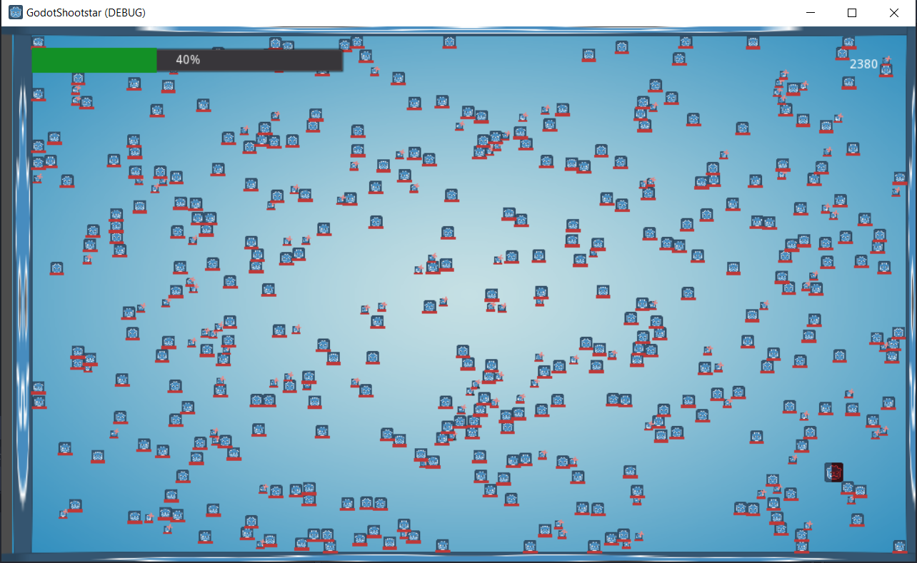
Result (Before)

Slide 10
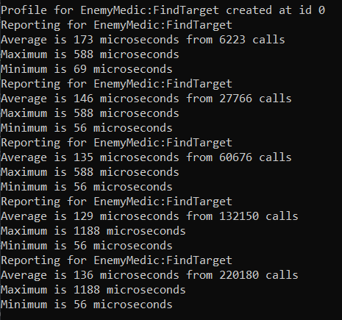
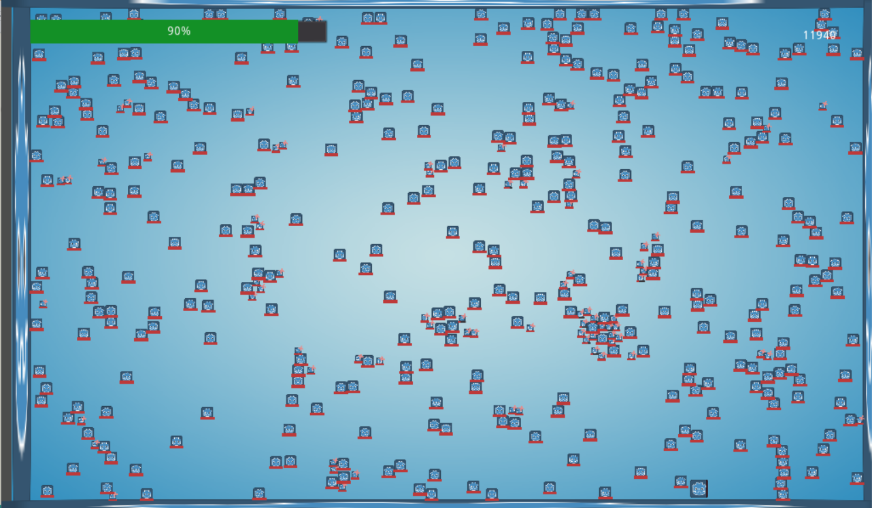
Result (After)

Slide 11
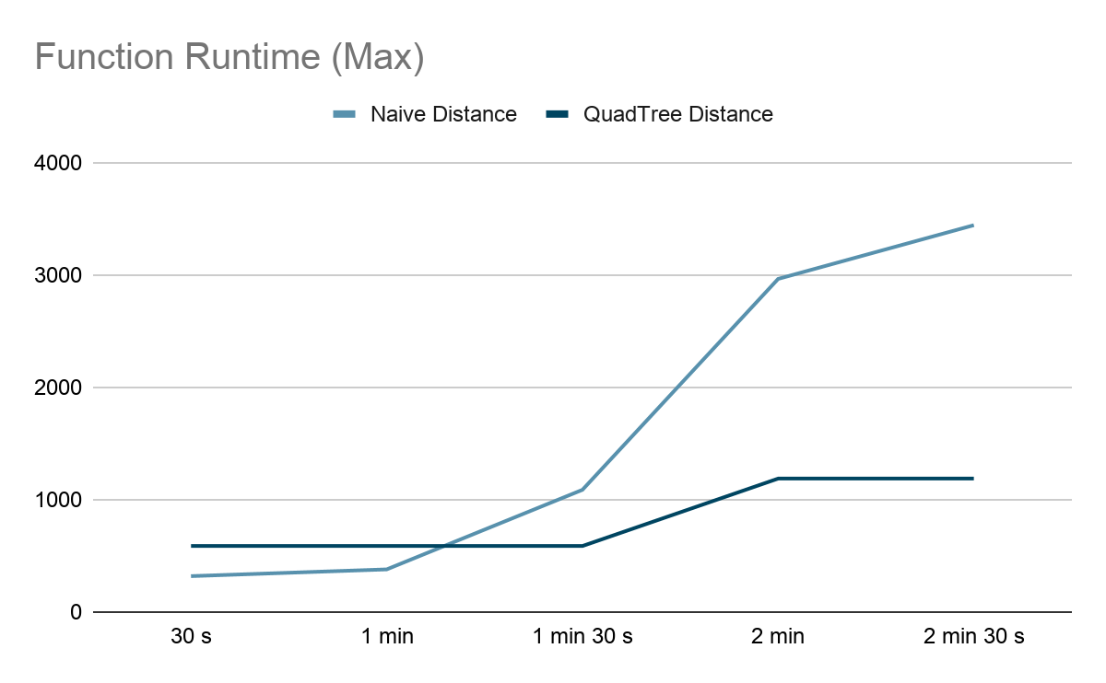
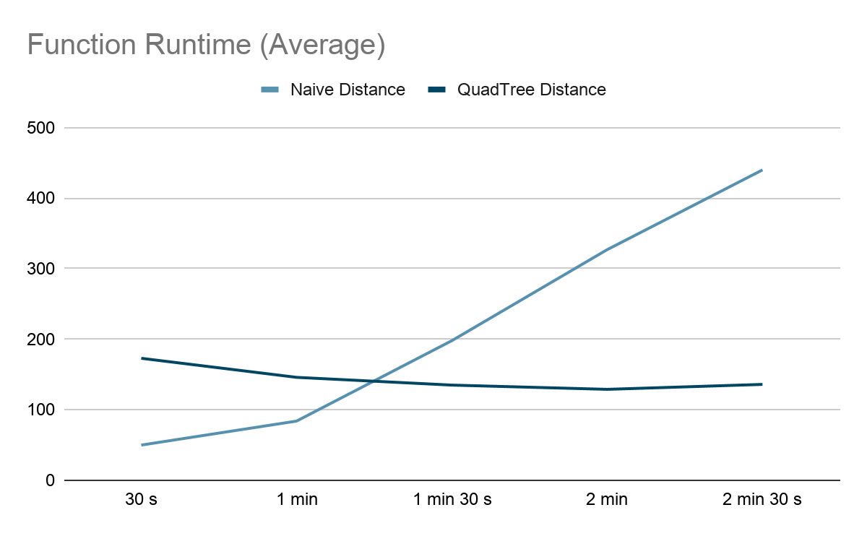
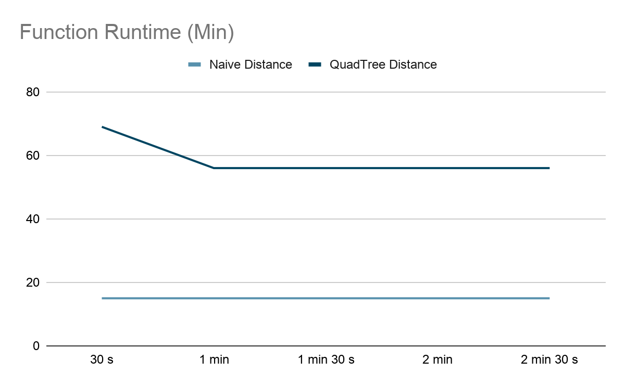
Result (Comparison)
X: Game runtime | Y: microseconds

Slide 12
Conclusion
QuadTree implementation scales better, able to keep average consistent function execution time. 3,23 times the speed at 2 min 30s game time (Average graph)
At best case, when enemy is only one or two, naive distance algorithm is better. (Min graph)
However maximum time always grows for naive distance, that is not the case for QuadTree (Max graph)

Slide 13
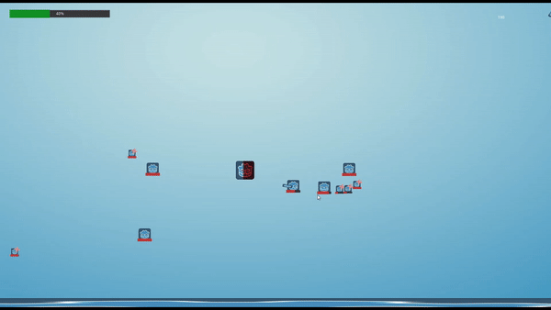
Thank You

